Slide 1
ELEC260 Week 4: Strain Gauges and Op-Amps

Slide 2
Unit Learning Outcomes
Demonstrate theoretical and practical use of a variety of sensors and actuators, including an understanding of interface electronics.
Demonstrate use and theoretical practical understanding of a modern microcontroller
Demonstrate practical use and theoretical understanding of electromechanics and small DC motors.
Demonstrate creativity and initiative in building small open ended mechatronic systems.
Demonstrate a qualitative understanding of system response, including 2nd order systems.

Slide 3

Notes:
Power meters for bicycles measure pedal force/torque, multiply it by pedal speed to get rider power. They measure force using strain gauges, which are small wires placed on the cranks. The wires change length by a tiny amount when the crank arm bends. A circuit measures this tiny change in resistance.

Slide 4
To measure forces we need to understand Stress and Strain
Stress (σ): The instantaneous load applied to a specimen divided by its cross sectional area before any deformation. SI unit (MPa)
= F/A (MPa)
Strain (ε): The change in gauge length of a specimen (in the direction of applied stress divided by its original gauge length.
ε=ΔL/L_{o}
Notes:
Write equations: sigma = F/Ao, epsilon =Delta L /Lo

Slide 5
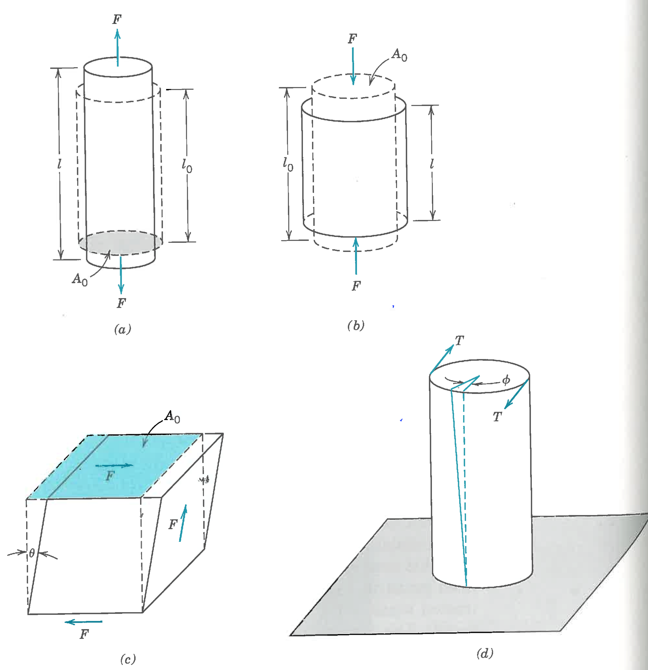
Compression
In this unit, you only need to consider tension and compression.
Notice that a material typically become more narrow under tension and wider under compression.
This secondary change in shape is defined using the Poisson ration: ν, pronounced “new”
More on this in 2 slides
Tension
Shear
Torsion

Slide 6
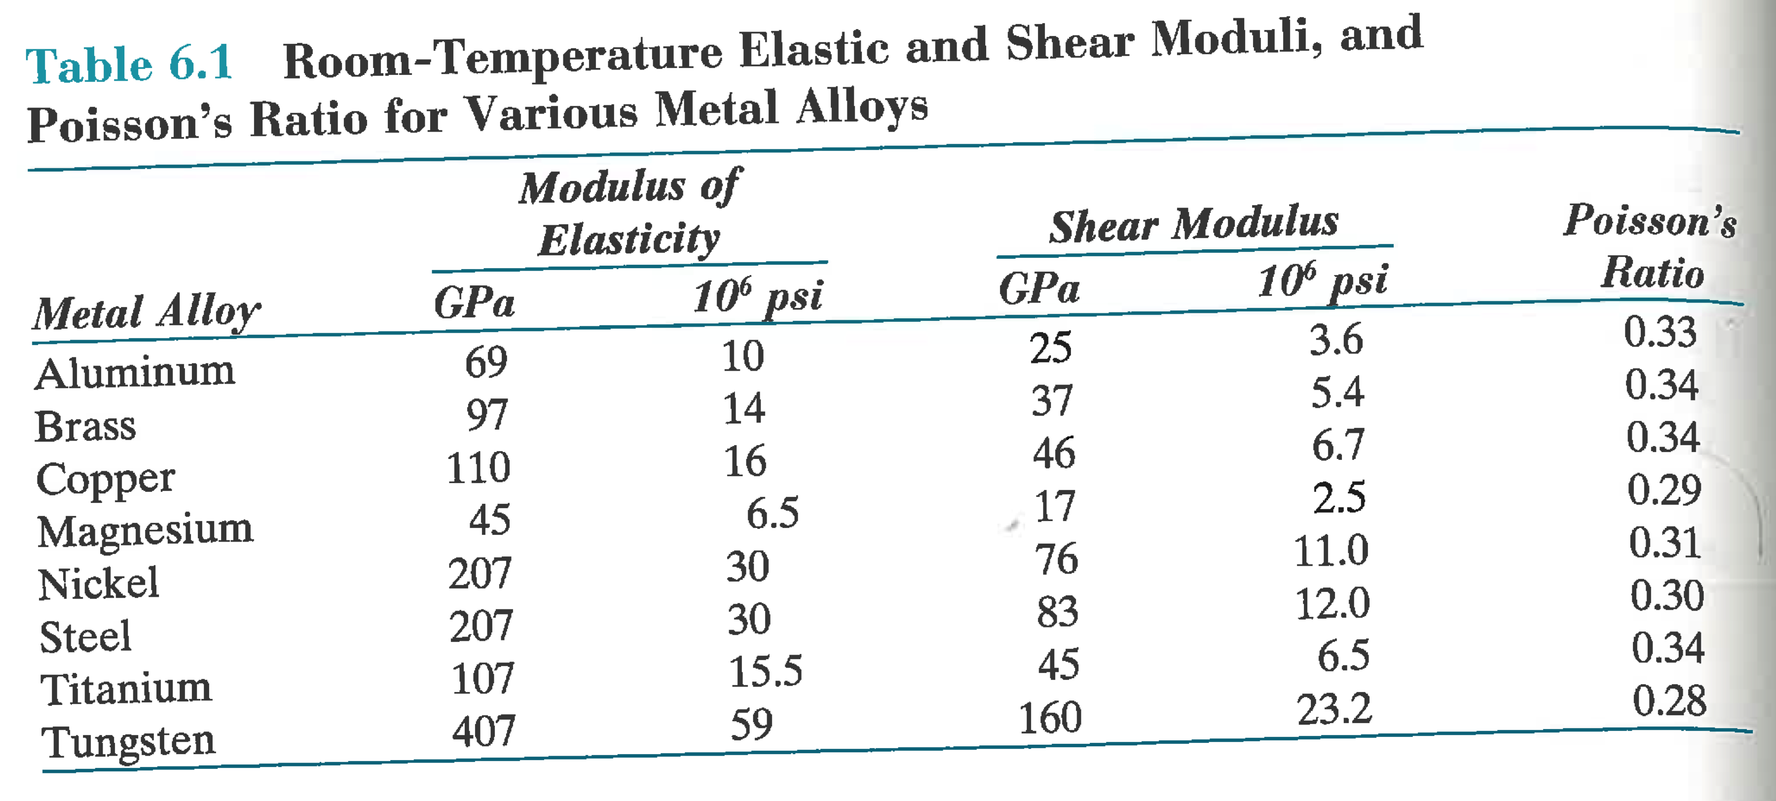
Stress-Strain Behavior
Metals under tension initially have a linear relationship between stress and strain.
The slope is the modulus of elasticity or Young’s Modulus,
E (Gpa)= stress/strain
Notes:
Draw plot of Stress vs Strain with linear line. Slope = modulus of elasticity
Write sigma = E epsilon
W=Tungsten
Compressive and tensile usually similar. Some time dependence

Slide 7
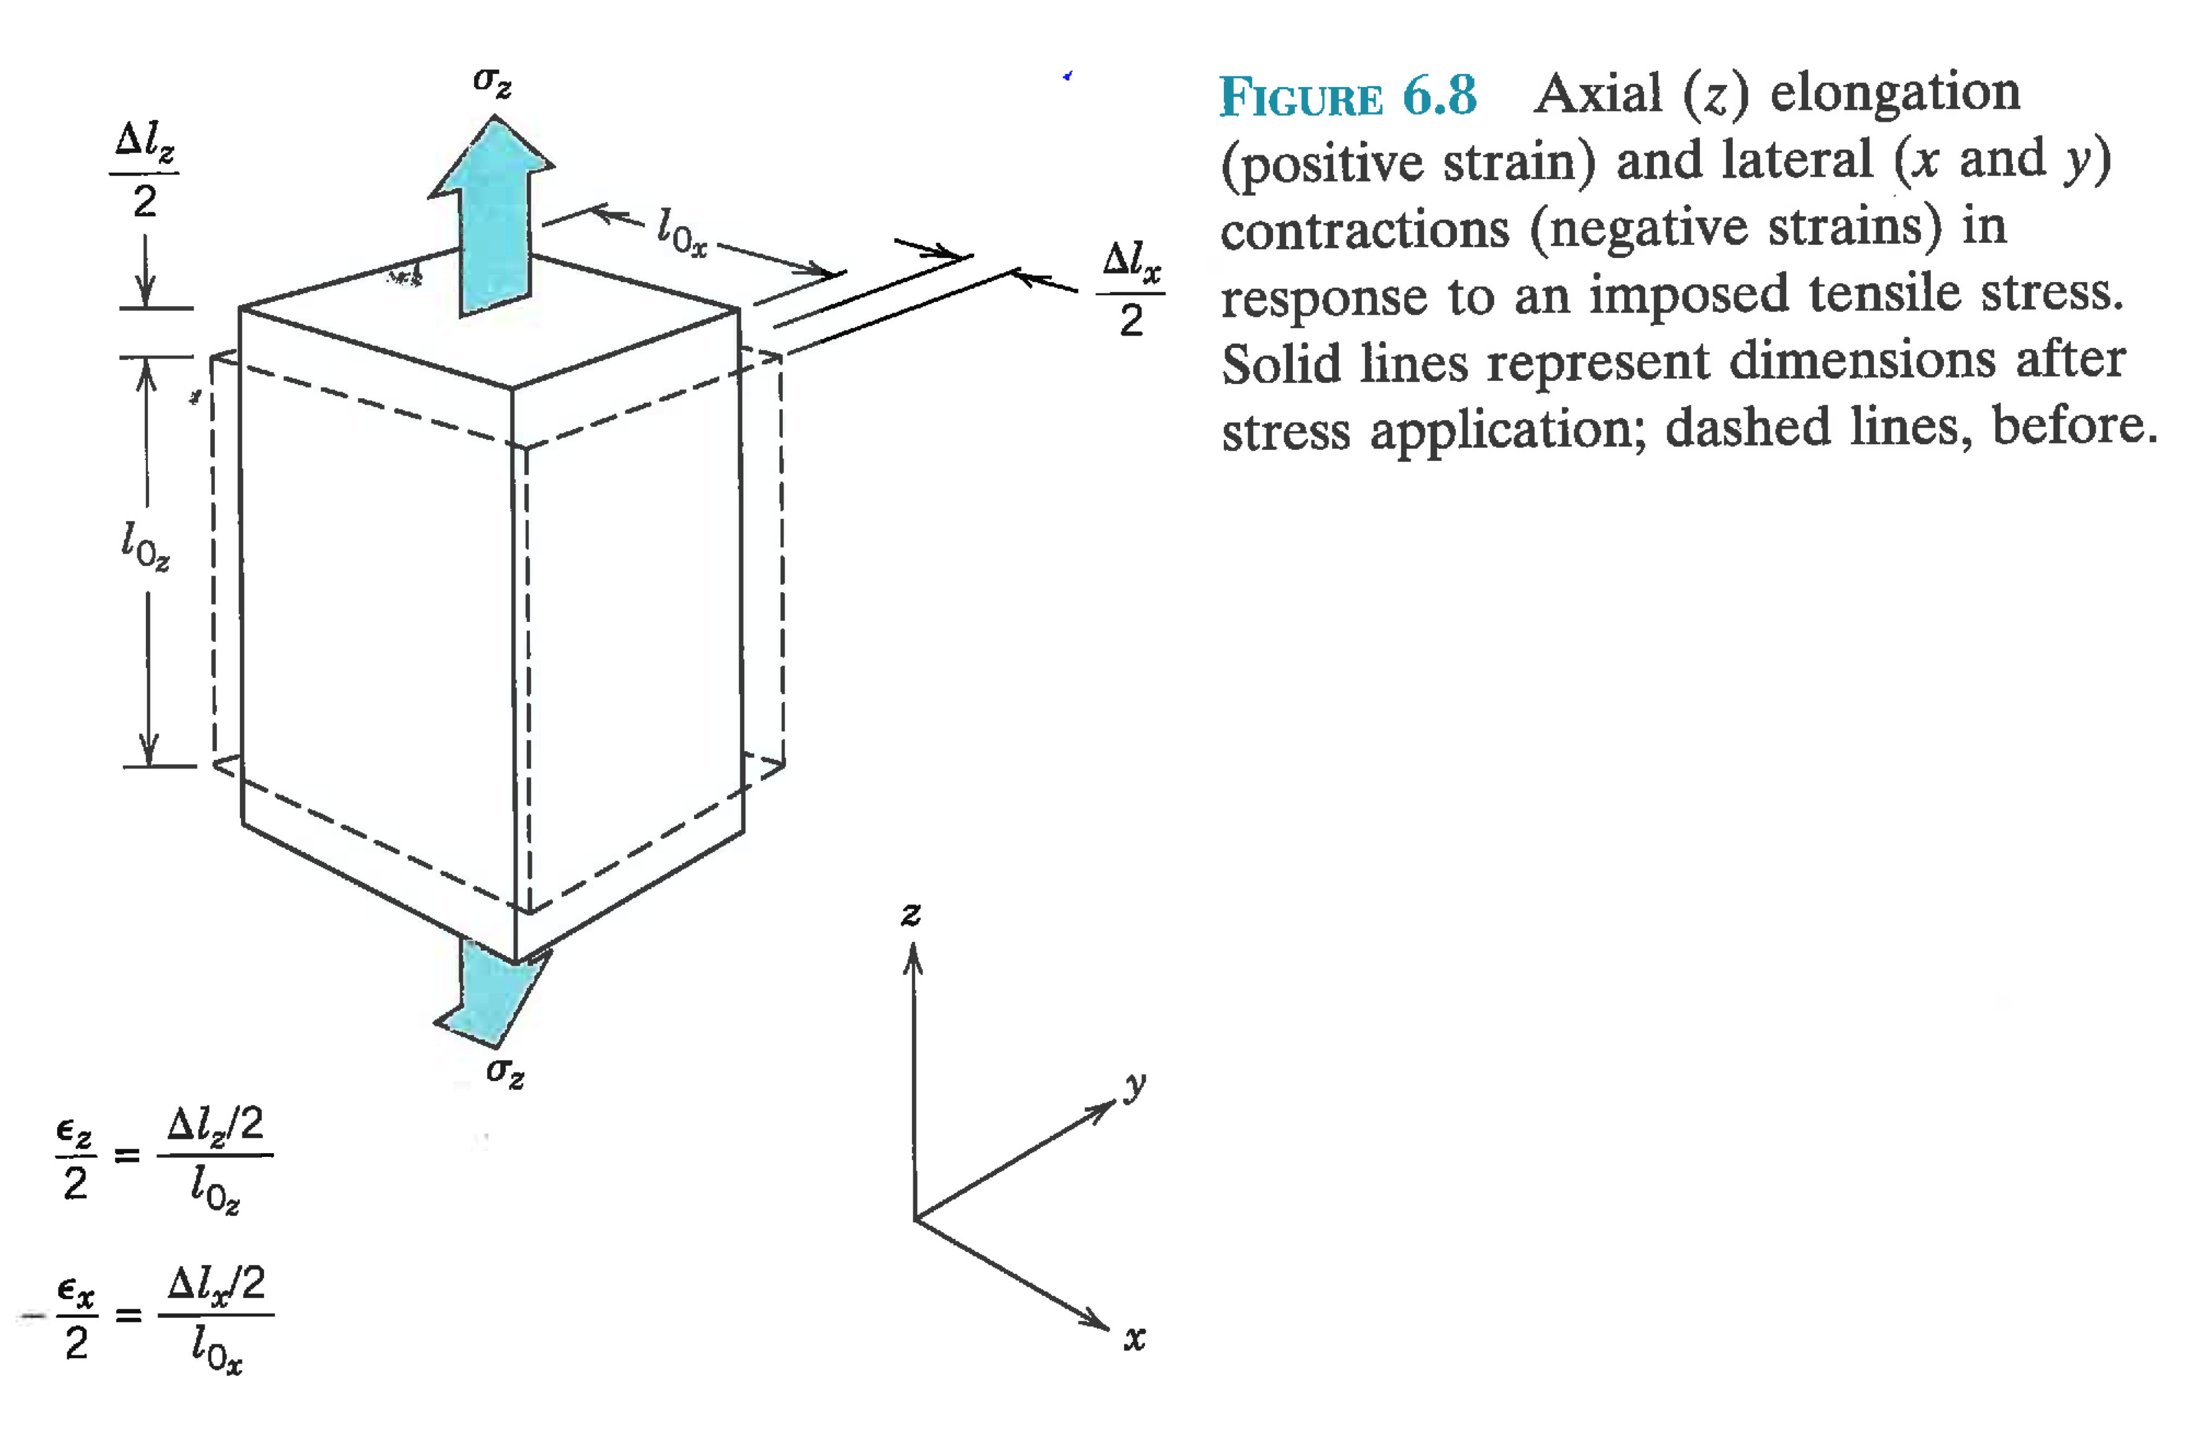
Poisson’s Ratio
Under Tensile stress, a material may contract in the perpendicular direction. The ratio of length change in lateral to axial directions or ratio of lateral to axial strain is Poisson’s Ratio.
ν=-ε_{lateral}/ε_{axial}
Where ε_{lateral} is the change in width divided by width.
Negative sign so
that ν is positive.

Slide 8
Example
A cylindrical, 300 mm titanium rod is pulled with a stress of 200 MPa. Assuming elastic deformation, what is the elongation and percent reduction in diameter?
Try this yourself. The solution is in the slide notes
Notes:
Stress = Force/area = 200e6 Pa
Modulus E = 107e9 Pa
E=stress/strain
Strain = stress/E = 200e6/107e9=1.87e-3
Strain = dL/L
dL = 1.87e-3*0.3m = 0.56mm
Reduction in diameter from Poisson Ratio = 0.34
Radial strain =dr/r = 0.34*1.87e-3 = 6.36e-4
% reduction in diameter = 6.4e-2% =0.064%

Slide 9
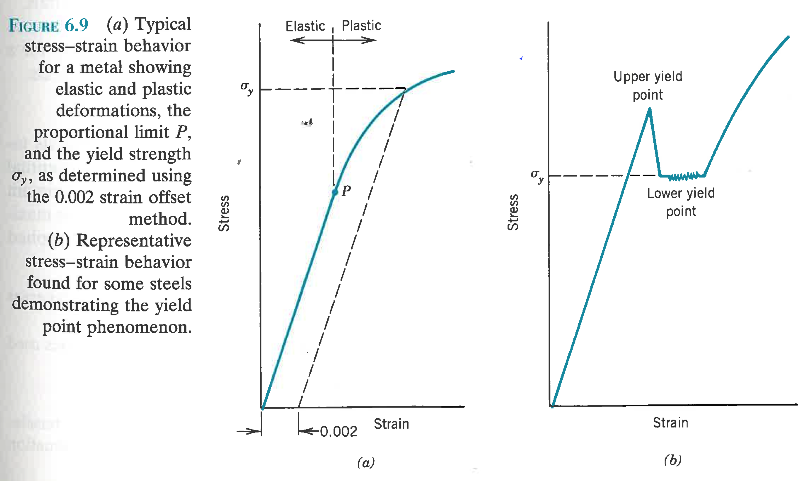
Elastic vs. Plastic Deformation
So far we have assumed elastic deformation. For metals it persists to strains of about 0.005 (0.5%)
Plastic deformation represents atomic bond breaking and re-forming. Metals typically get weaker (lower slope), some polymers get stronger (cable ties)
Yield strength is variously defined but usually represents the onset of plastic deformation.
Designs should limit stress to elastic region (below yield strength)
Notes:
What happens when you unload in the elastic/plastic deformation regions?

Slide 10
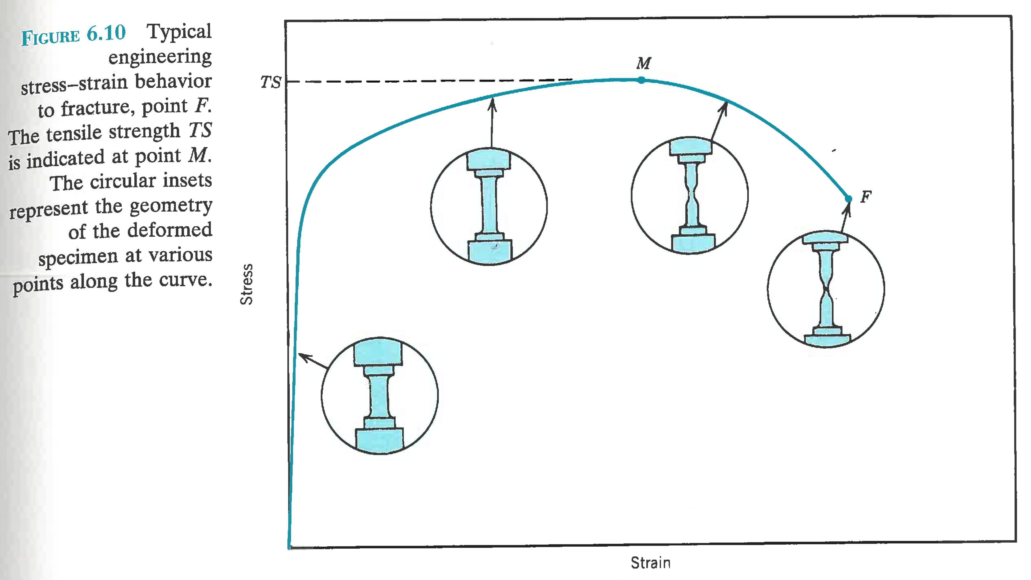
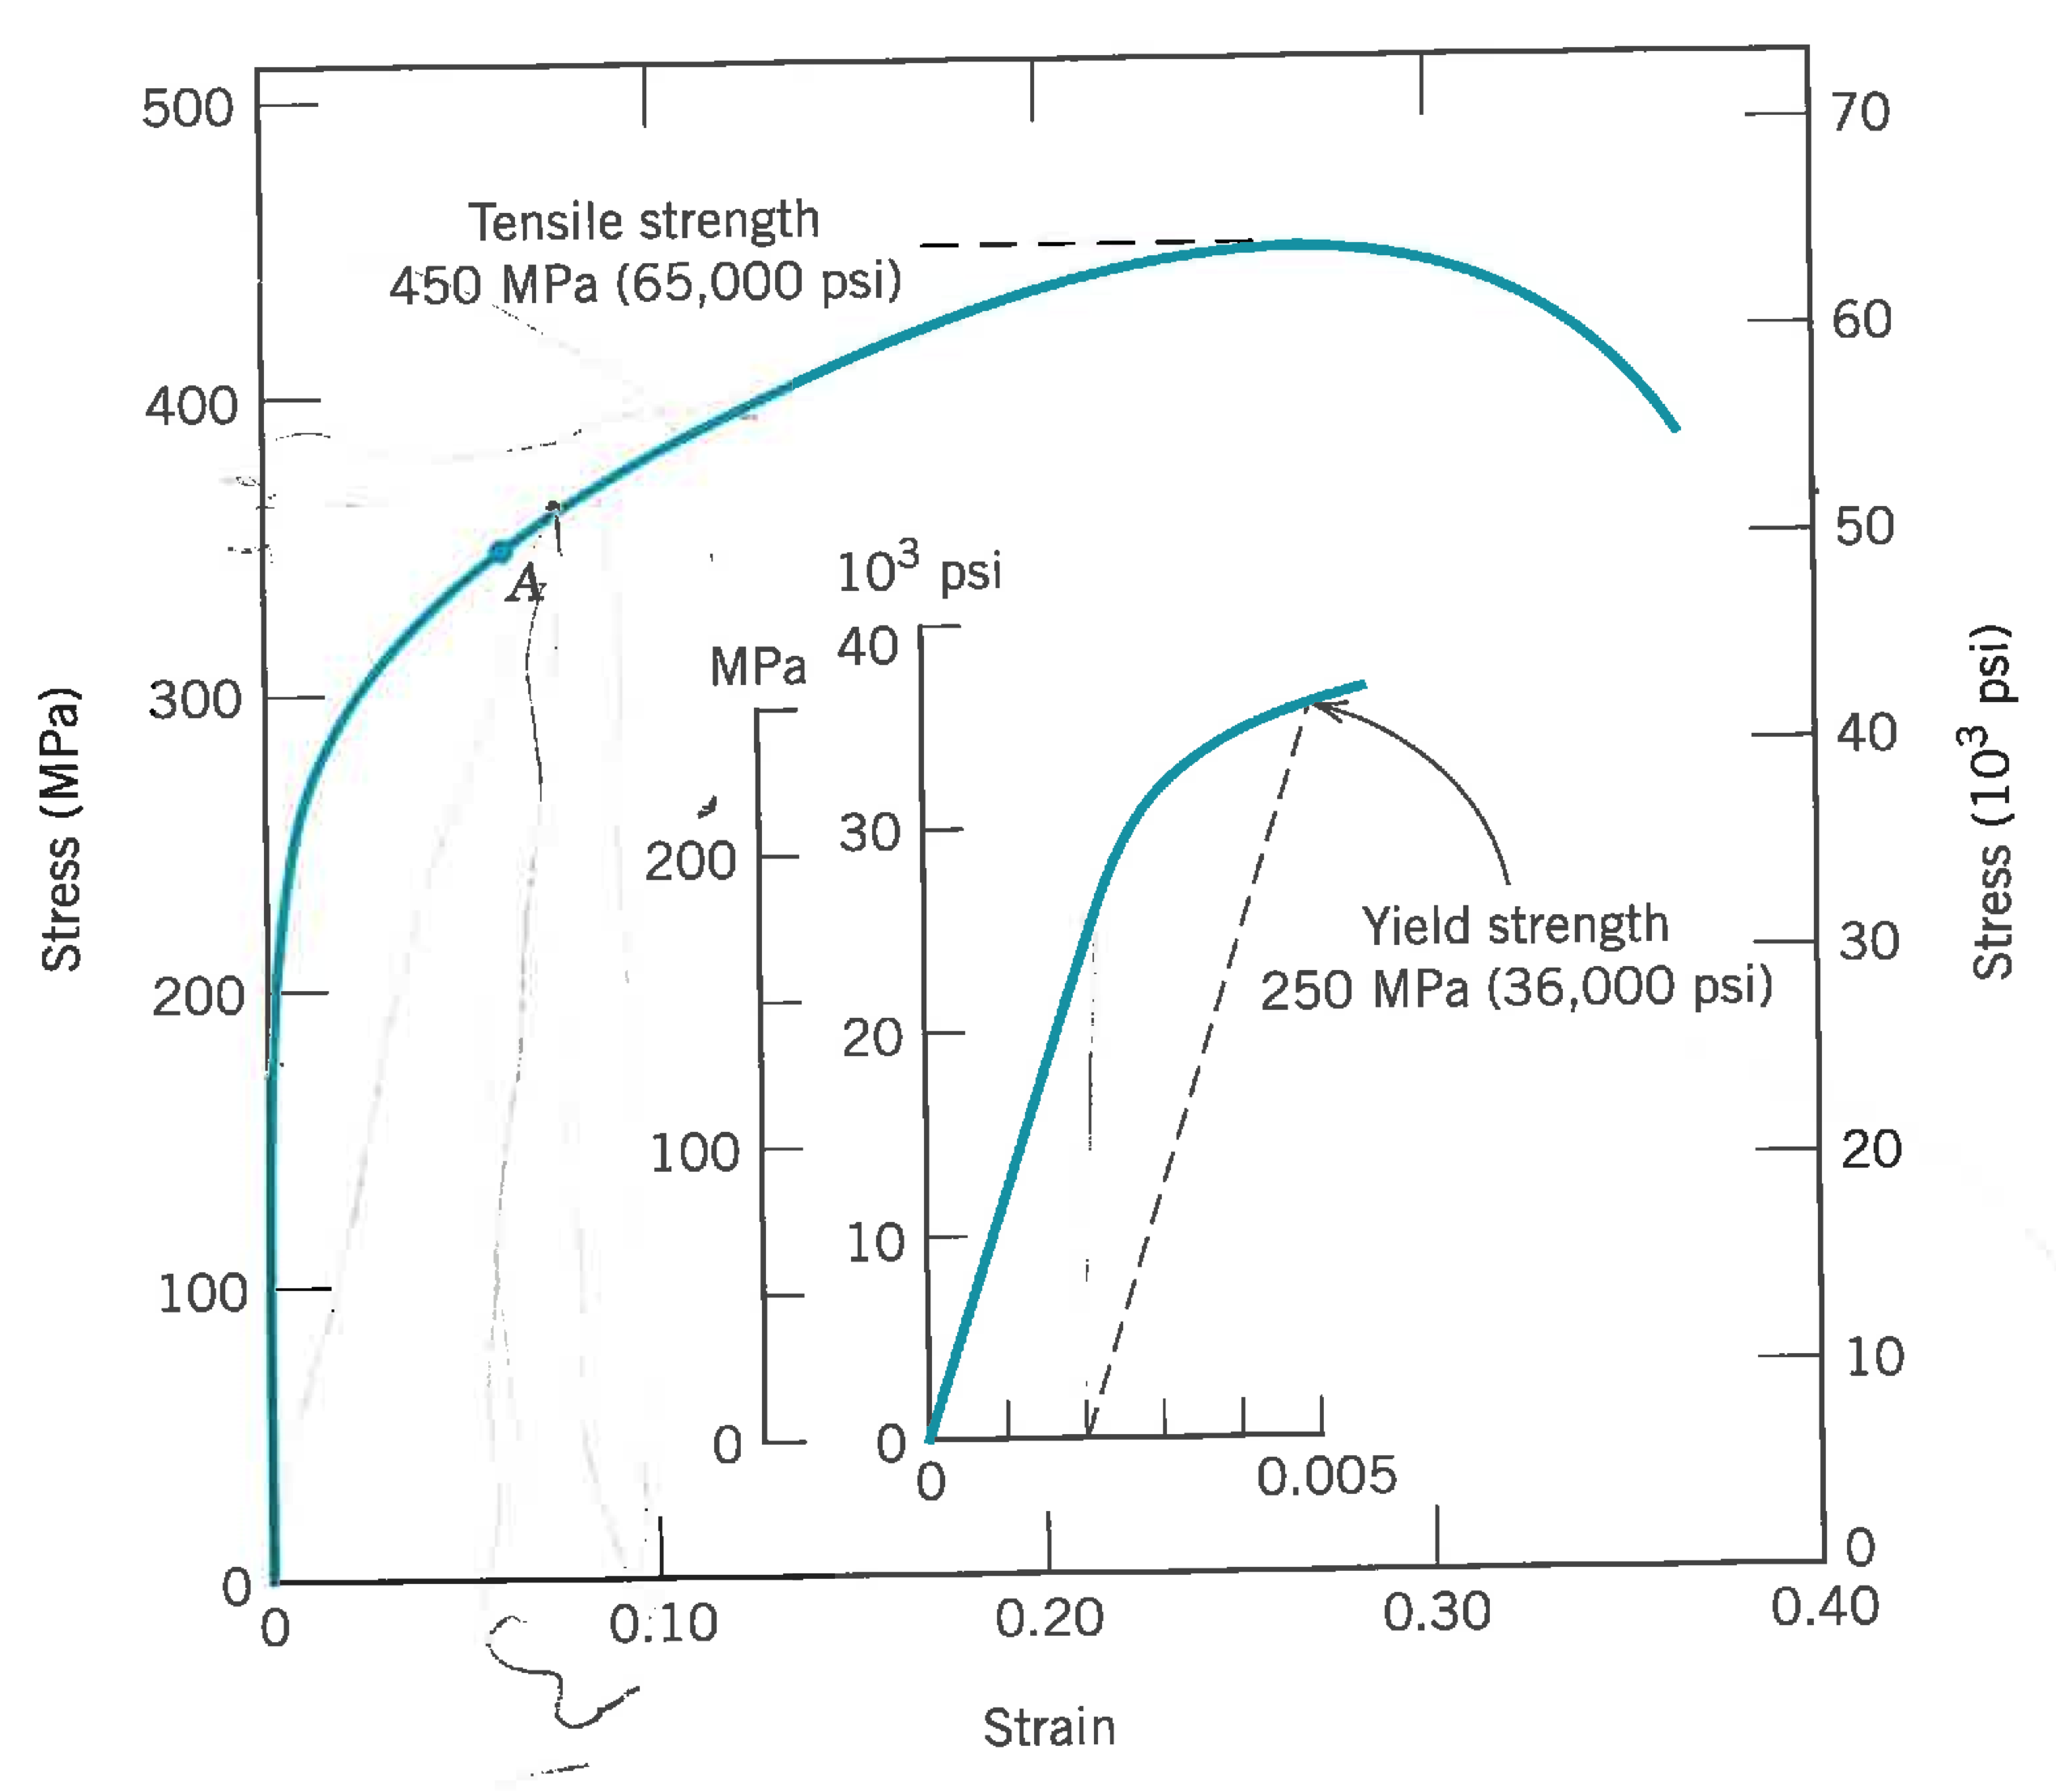
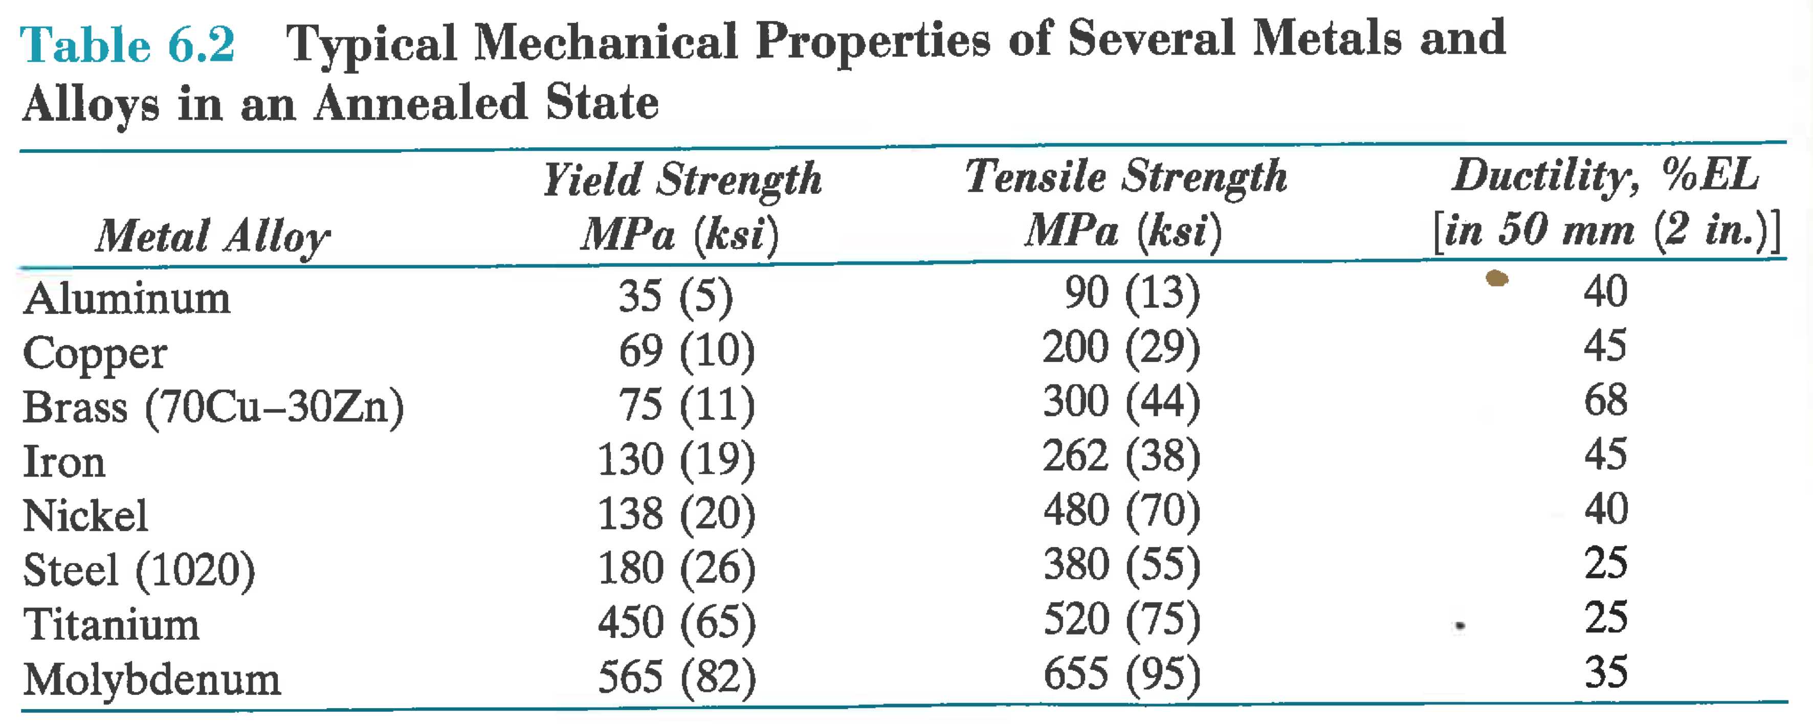
Tensile strength (TS) is the ultimate stress that a material can sustain. May be much above the yield stress.
Notes:
Inset is brass

Slide 11
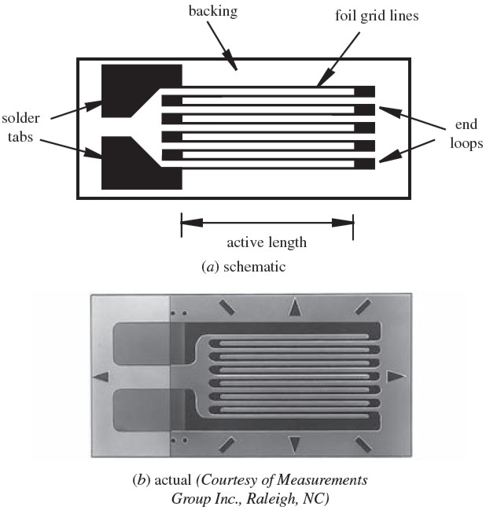
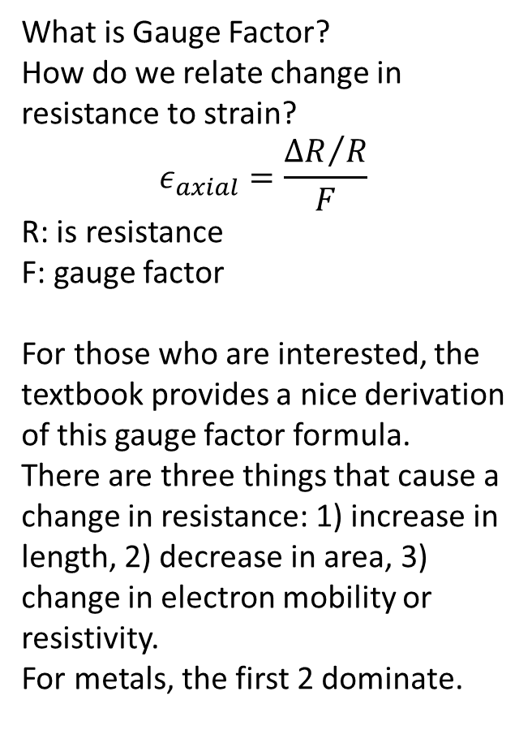
Strain gauges
What is Gauge Factor?
How do we relate change in resistance to strain?
$$ε_{axial}=\frac{{∆R}/R}{F}$$
R: is resistance
F: gauge factor
For those who are interested, the textbook provides a nice derivation of this gauge factor formula.
There are three things that cause a change in resistance: 1) increase in length, 2) decrease in area, 3) change in electron mobility or resistivity.
For metals, the first 2 dominate.
Notes:
look up a kitchen scale hack.
First take a minute to talk about stress and strain

Slide 12
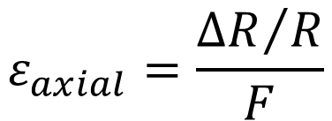
Strain Gauge Resistance Example 9.1
If a 120 Ohm strain gage with a gage factor F of 2.0 is used to measure a strain of 100 με (100 microstrains), how much does the resistance of the gage change from the unloaded to the loaded state?
$$ε_{axial}=\frac{{∆R}/R}{F}$$
Notes:
Strain =DR/R/F
dR = strain*F*R =100e-6*2.0*120 = 0.024 Ohms

Slide 13
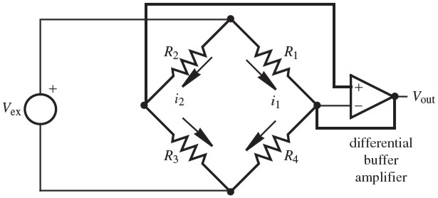
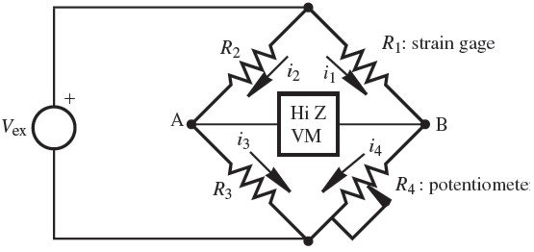
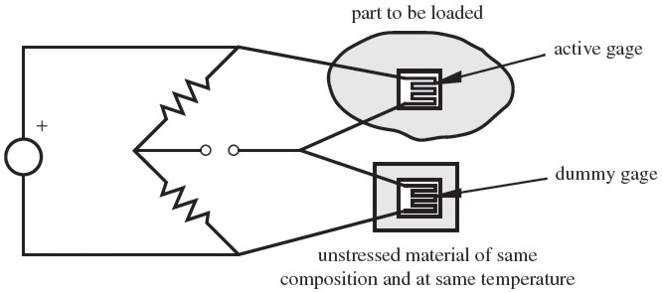
Strain Gauge Circuits
Must measure very small changes in resistance: Wheatstone bridge
Measure voltage, formula gives Resistance
R₂ and R₃ are high precision resistors of equal value.
R₄ is high precision pot. Adjust pot until V_{A} = V_{B}
Notes:
Bottom right is for temperature compensation
Hi Z VM is a high internal impedance volt meter.

Slide 14
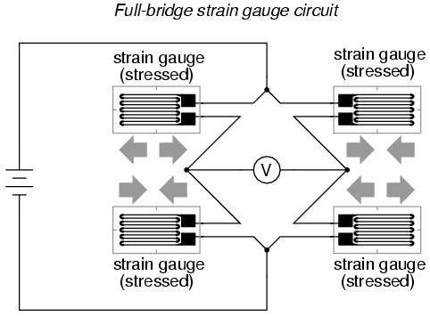
What is V_{out} as a function of R₁, R₂, R₃, R₄ and V_{ex}?
Try Deriving it!
Notes:
Vout = Vex[R1/(R1+R4) – R2/(R2+R3)]

Slide 15
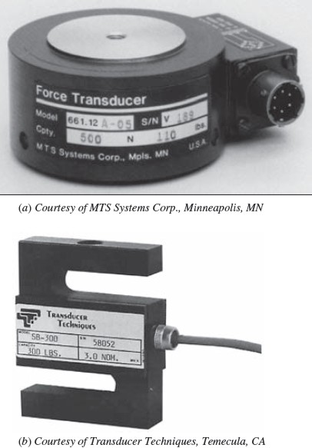
Load Cell
Calibrated strain gauges bonded to a deformable material.
Use Hooke’s Law σ=Eε to convert strain to stress to force. E is modulus of elasticity
Used in scales and test equipment such as the one you will use in lab.

Slide 16
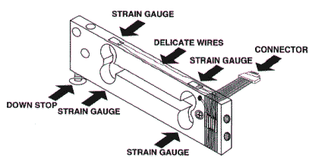
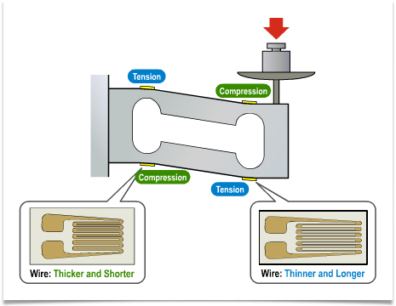
Load Cells use one or more Strain gauges
The load cells you will use in the lab have 4 strain gauges connected in a wheatstone brigde. This produces 4 wires. There is one extra wire to act as an electrical shield to reduce noise.
https://learn.sparkfun.com/tutorials/getting-started-with-load-cells
More on scales:
http://www.scalenet.com/applications/glossary.html

Slide 17
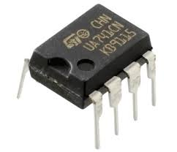
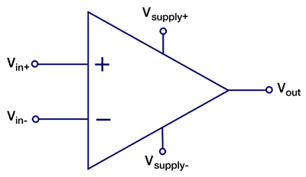
Operational Amplifier: Op Amp
We use Op-Amps for analog signal processing, the first step before A to D conversion
If you tried to use the A2D converter on the Arduino to measure V_{out} your scale would have very poor resolution.
Mostly for acquiring signals that may be
too small,
too noisy
have an offset or
not be in the right format
We will only consider the ideal Op-Amp, which is not the same as the real Op-Amp

Slide 18
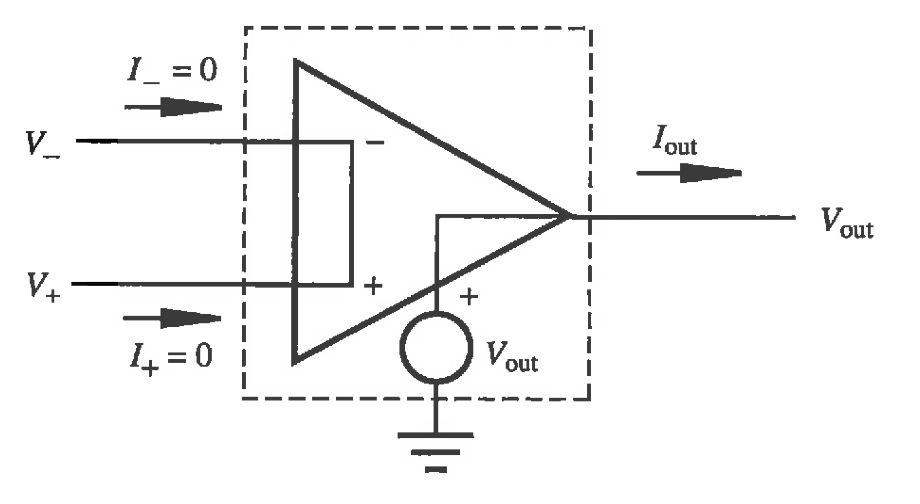
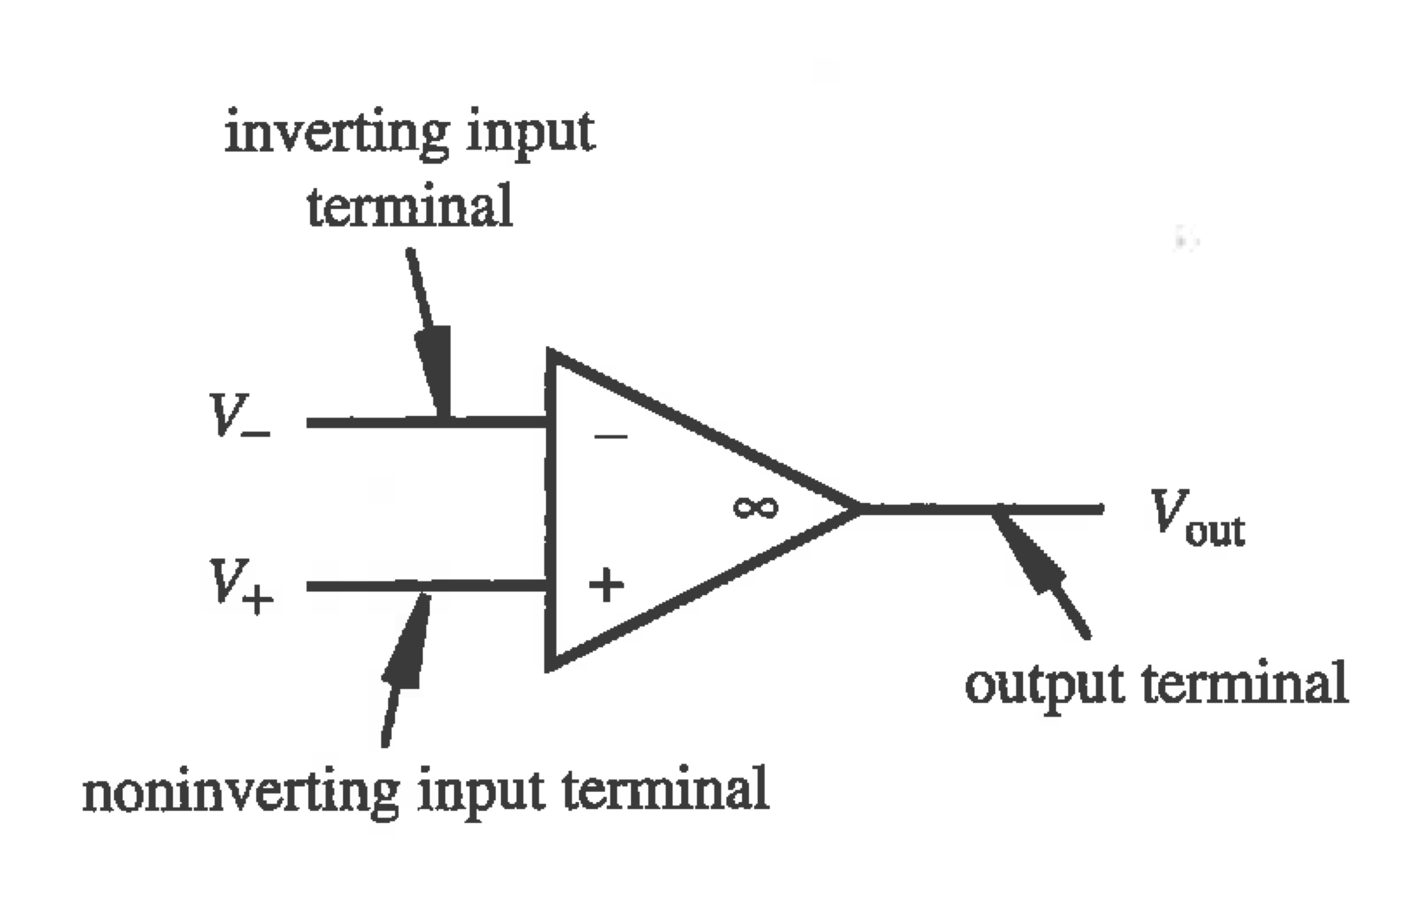
Operational Amplifier
V_{out} is ~infinity times (V₊ - V₋)
Note, typically supplied by a positive and a negative supply.
The ideal OP AMP
Infinite input impedance: I₊ = I₋ = 0
Infinite gain V_{out} = Gain(V₊ - V₋), therefore V₊ = V₋ in negative feedback
Zero output impedance

Slide 19
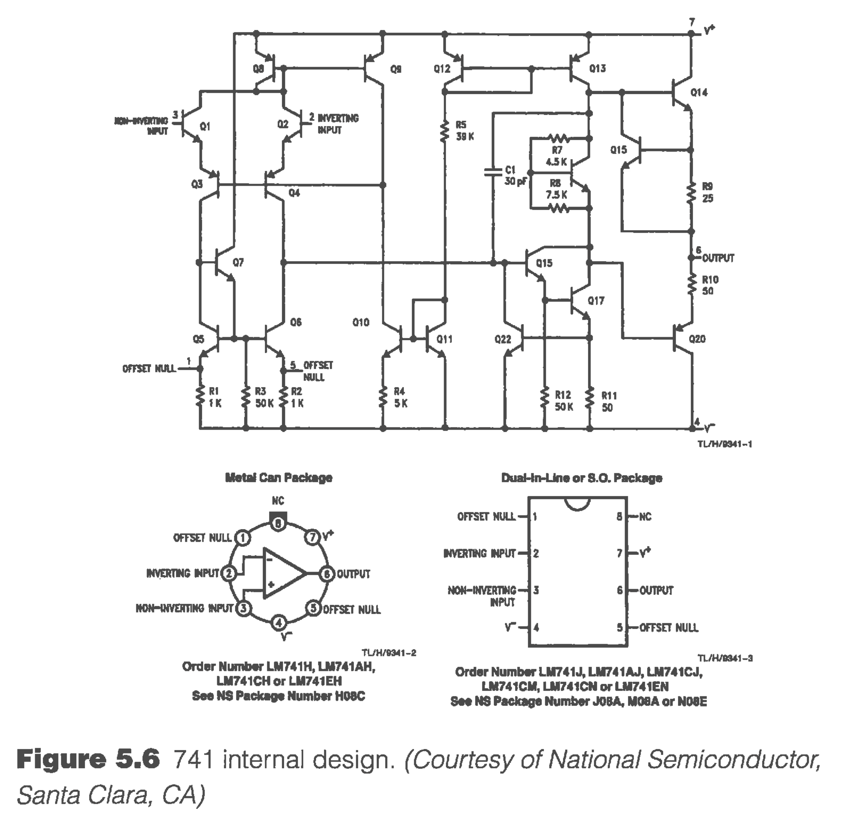
What’s inside an Op-Amp?
A bunch of BJTs, some resistors and a capacitor
Typically available as 8 pin can or DIP.

Slide 20
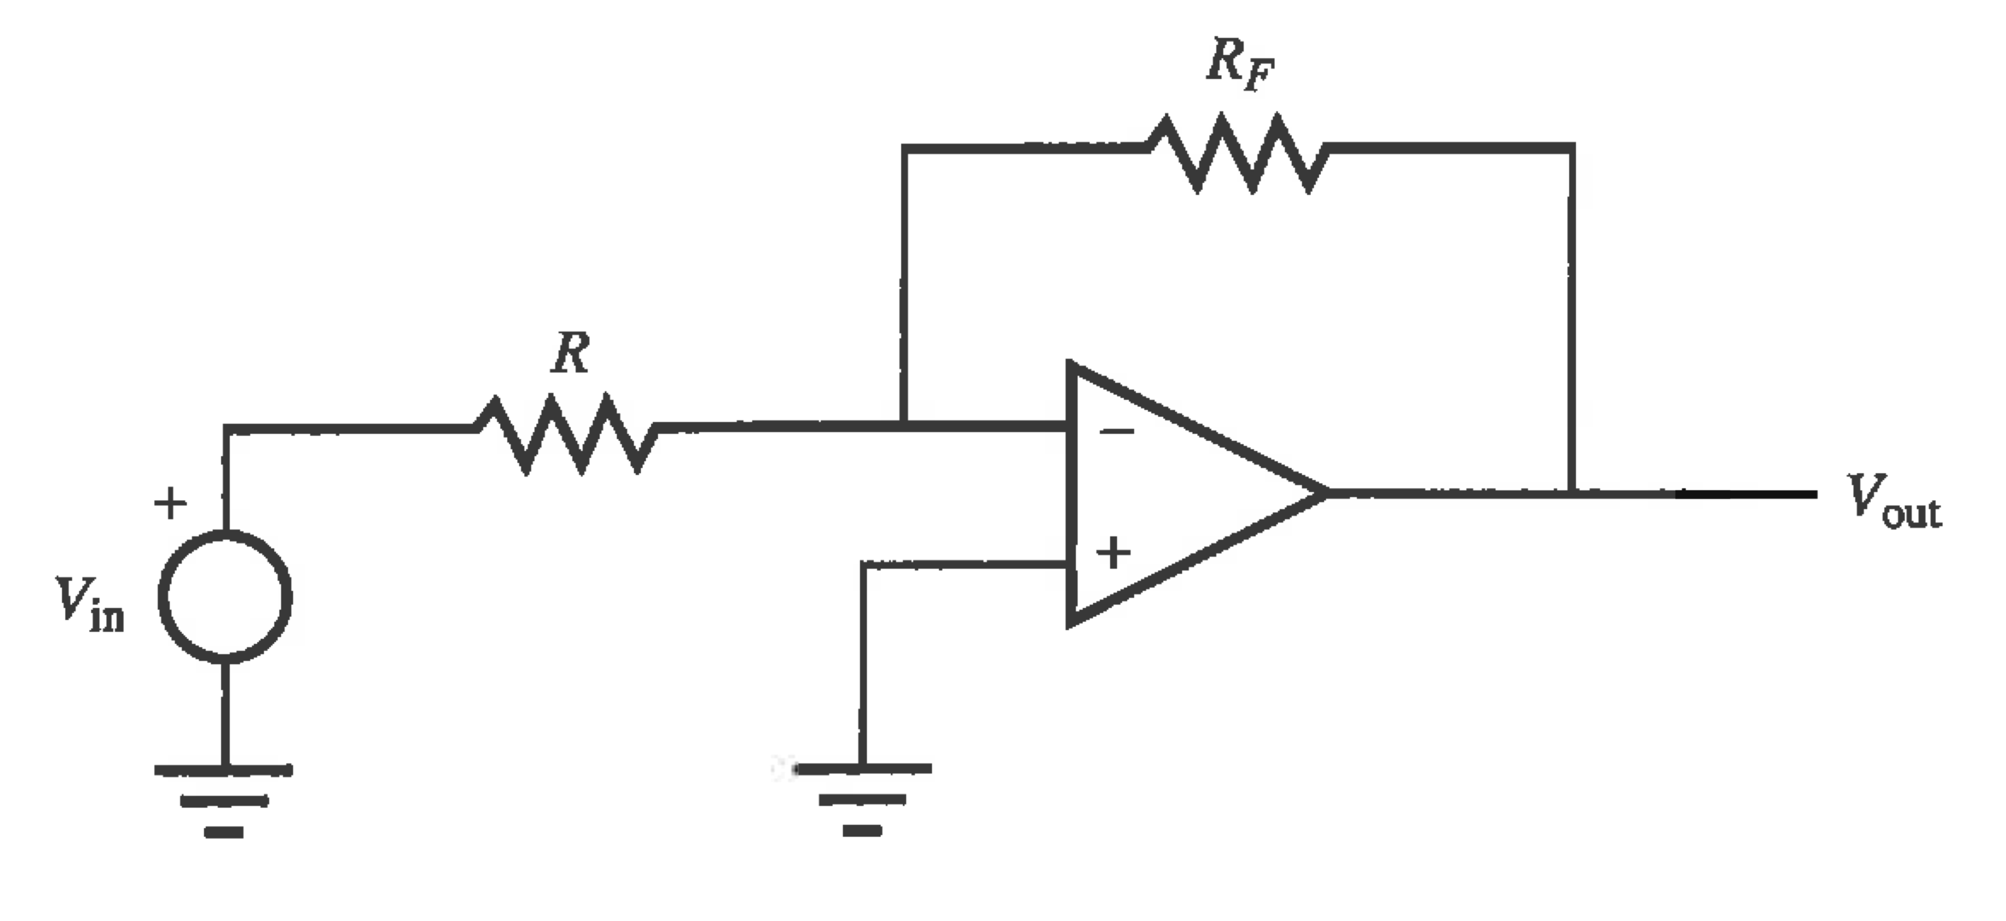
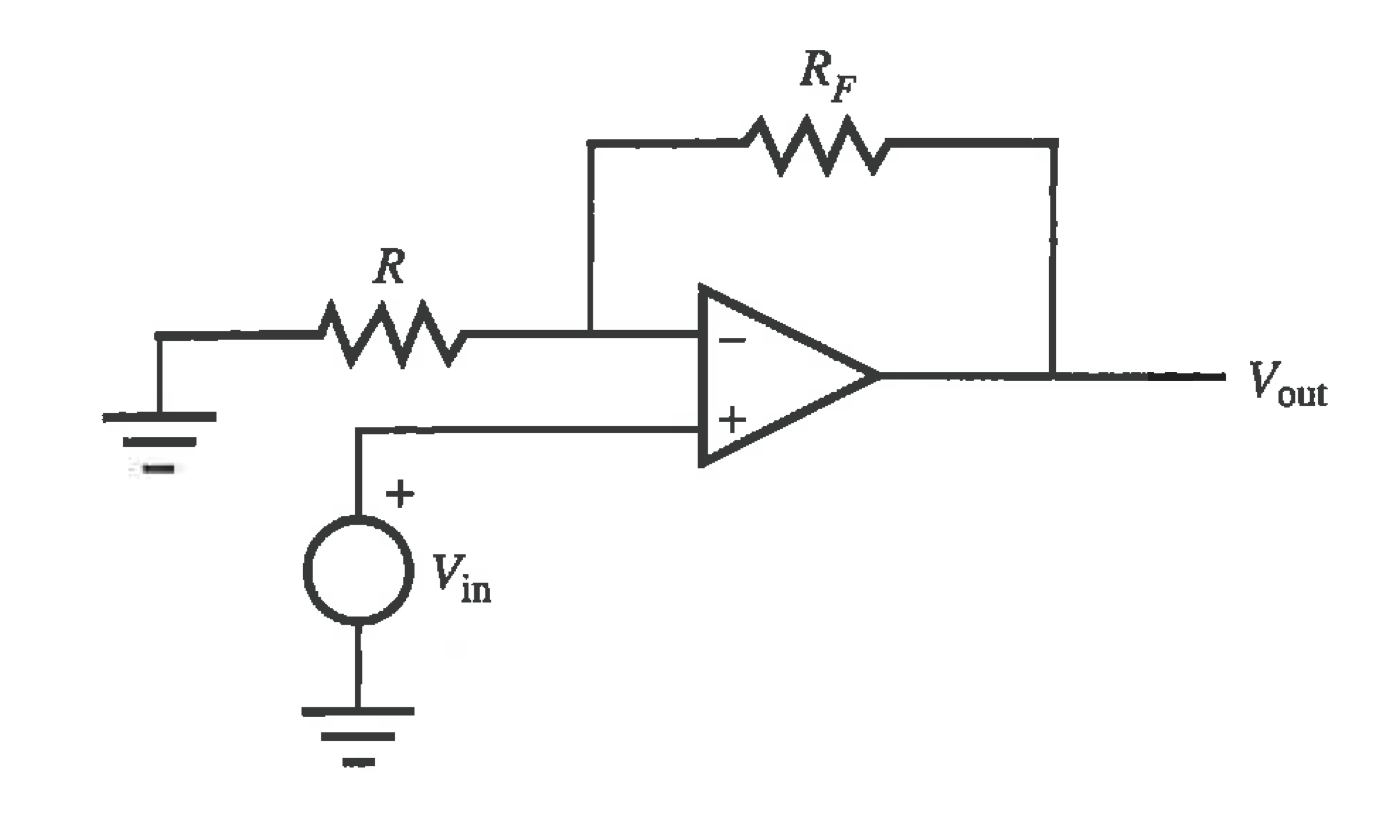
Inverting Amp
Non-inverting Amp
See the EEV Blog video on ilearn. In that video he does not derive the gain formulas for these circuits.
Here is a derivation for the inverting circuit: https://youtu.be/vjY4ikMxwGw
Here is a derivation for the non-inverting circuit: https://youtu.be/gjfCGhaMttc
With some practice, these derivations should be straightforward.
When solving Op-Amp circuits we usually assume an ideal Op-Amp
Notes:
When Rf=0 and R= infininty we get the buffer or follower. Useful for reading a voltage without drawing any current.

Slide 21
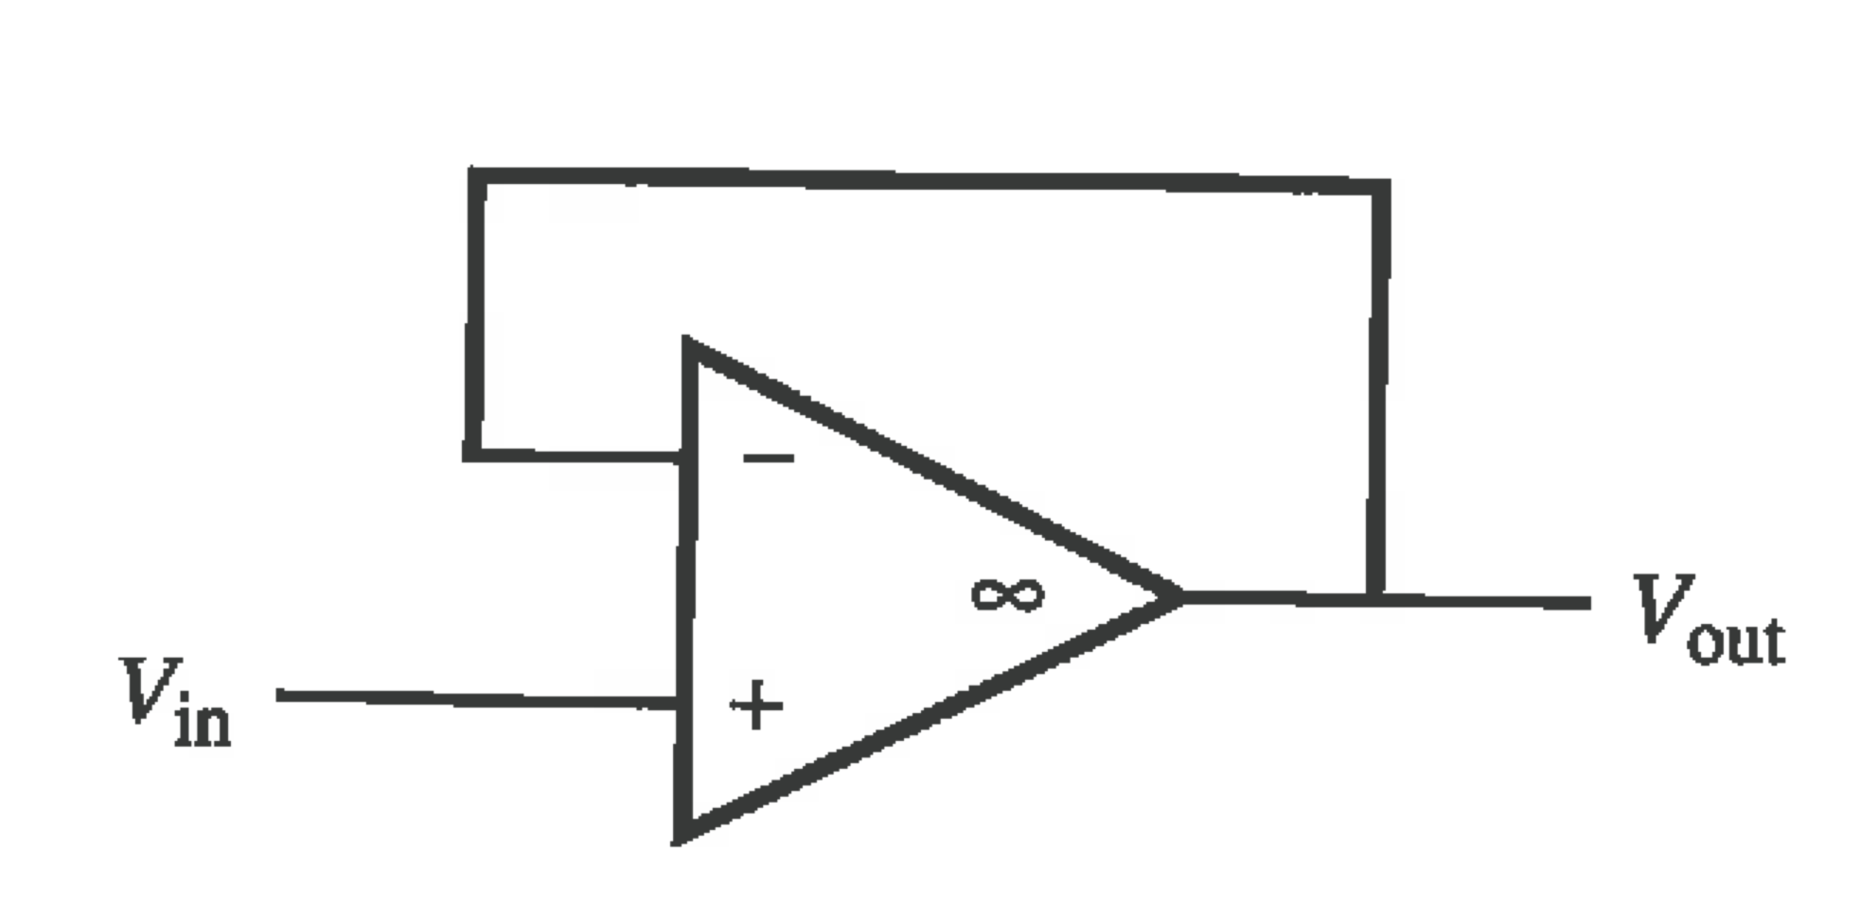
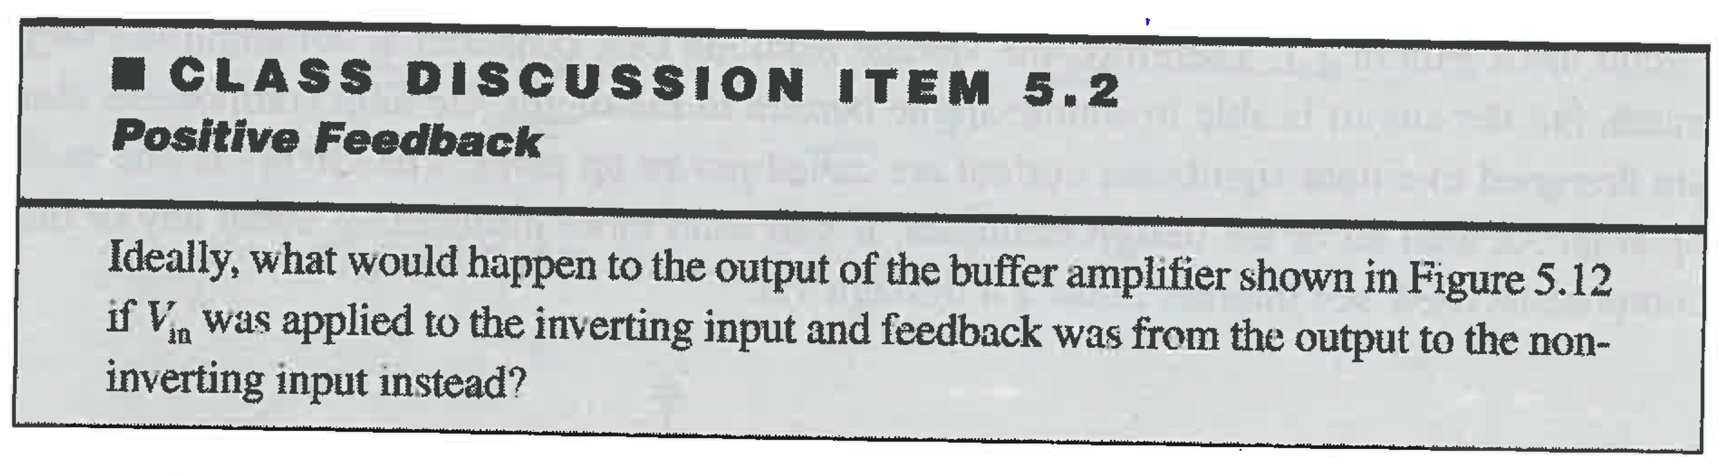
Can make a good oscillator with an op and a capacitor using positive feedback
EXAMPLE QUESTION 5.1 from text:
An inverting op amp circuit is designed with ¼ W resistors. If the input voltage is 5V, what are the minimum required values for the input and feedback resistors if the gain is a) -1 and b) -10.
Hint: consider the current in the feedback resistor.
Answer: a) R1 & R2 >= 100 Ω
b) R2>= 10 kΩ, R1>= 1 kΩ

Slide 22
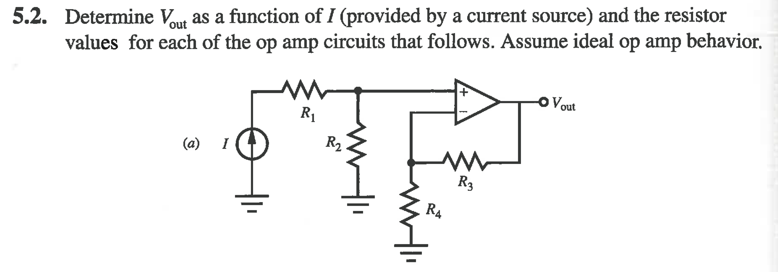
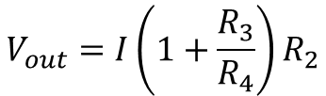
Example 1
Answer
$$V_{out}=I\left(1+\frac{R_{3}}{R_{4}}\right)R_{2}$$

Slide 23
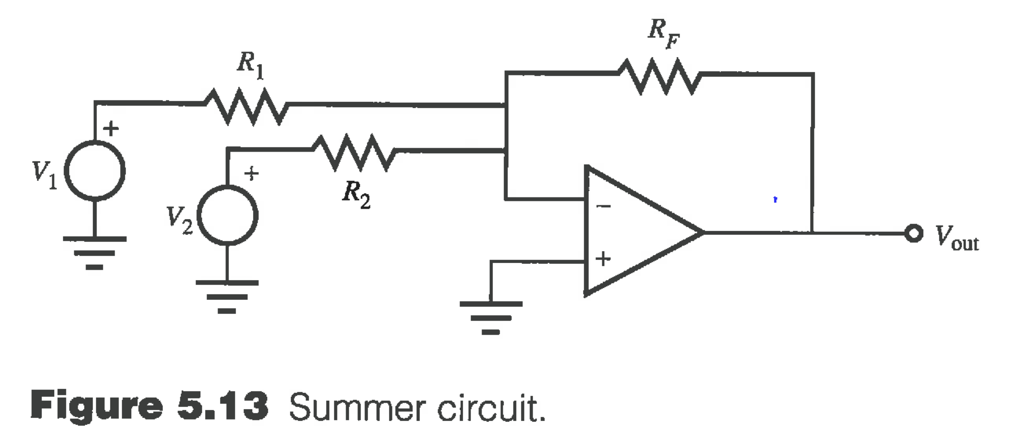
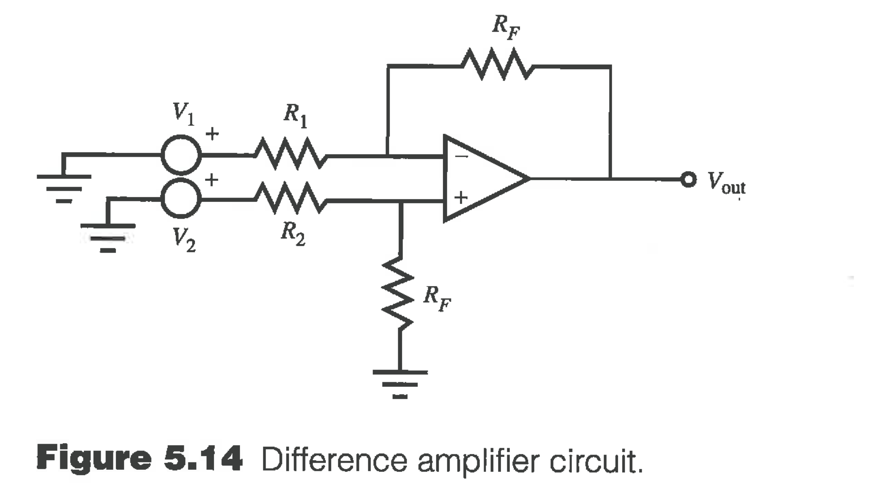
Summer Amp
Difference Amp
Superposition Principle: For a linear system, we can analyze the inputs separately and sum their results
When R₁=R₂=R,
Vout=R_{f}/R (V₂-V₁)
This works alright for sources (V1 & V2) with low output impedance. But for sources that cannot supply much current we use an instrumentation amplifier. It uses 3 op amps and has very high input impedance.
Notes:
Summing amp: Vout = -Rf/R *(V1+V2)

Slide 24
Instrumentation Amplifier will use INA125P in lab
A standard difference amplifier does not have a high input impedance.
An instrumentation amplifier is a fancy difference amplifier.
An instrumentation amplifier is normally a monolithic IC containing resistors and op-amps. It has
very high input impedance
Large common mode rejection ratio (CMMR) (ratio of average gain to difference average gain. zero in theory).
Consistent bandwidth over a large range of gains.
Gain is typically set by an external resistor.
Getting a low CMRR is achieved by making the entire device on one chip and laser-trimming resistors to balance the gain of the + and – channels.
See INA125P example data sheet for gain equation, output range, CMRR, bandwidth.
See two examples of hacking a kitchen scale: pdf and http://forum.arduino.cc/index.php/topic,192016.0.html

Slide 25
Example: For a full-bridge load cell, supplied with 10V, a) what voltage would be observed if 70 micro strains were experience by each branch? Each strain gauge has a gauge factor of 2 and a nominal resistance of 120 Ω. b) what instrumentation amplifier gain should you choose if used with an Arduino?
Consider the circuit.
The fractional change in resistance for each branch is +/- 2.0(70e-6)
The resistances are 120.0168 and 119.9832
Vout = 10(119.9832/240-120.0168/240) = -1.4 mV (Equation 9.21 from text)
Uh, Oh, its negative. Arduino can’t measure negative voltages… But we can flip the load cell around, or even easier, flip the green and white wires around!
I would use a gain 5/0.0014 = 3600 to make full use of the 5 volt analog input range.

Slide 26
Example 9.16 from text: A steel bar with modulus of elasticity 200 GPa and a diameter of 10 mm is loaded in tension with an axial load of 50 kN. A) What is the stress in the bar? B) If a strain gage of gage factor 2.115 and a resistance of 120 Ω is mounted on the bar in the axial direction, what is the change in resistance of the gage from the unloaded state to the strained state? C) The strain gage is placed in one branch of a Wheatstone bridge (R1), with the other three legs having the same base resistance but not strained. If the bridge is supplied with 5V and the output voltage is amplified by 800, what is measured output voltage in the strained state?
6.37e8 Pa
0.8080 Ω
6.71 V

Slide 27
A new experimental strain gauge is mounted on a 2 mm diameter stainless steel (AISI 302) bar in the axial direction. The gauge has a measured resistance of 120 Ohm, and when the bar is loaded with 200 kg in tension, the gauge resistance increases by 0.77 Ohm. What is the gauge factor of the gauge?
Answer: F=1.85 to 2.0 depending modulus
Find v_{o} and i_{o} for the circuit on the left.
How much current is the op-amp sourcing or sinking through its output?
Answers: a) -30 V, 3.5 mA
b) 5 mA sinking. This is beyond the specification of a typical real opamp.

